Slide 1
Class 3.7 – Inheritance & Diagrams
Class 3.7 – 1/7/19
Instructor: Hank dedona

Slide 2
Class 3.6 Recap
Special (Object) methods
toString()
hashcode()
getClass()
clone()
equals()
@override annotation
Single responsibility principle

Slide 3
Extending
Inheritance in Java is very similar to the same concept in Python.
We extend another class to inherit its data and behaviors (that is, fields, properties, and methods)
In Java, we use the EXTENDS keyword to extend an existing class (inherit from)

Slide 4
Cat example
public class Cat {
// ...code for the Cat class...
}
public class HouseCat extends Cat {
// ...code for the HouseCat class...
}
In this example the class HouseCat would have access to all (except private) fields, methods, etc in the Cat class.
In other words: we say that HouseCat is a subclass, derived class, or child class of Cat, and we say that Cat is the superclass, base class, or parent class of HouseCat

Slide 5
Class extending in java (inheritance)
Note: In Java, you can only extend (subclass, etc) one class.
Inheritance is a useful mechanism for sharing data and behavior between related classes, and it effectively creates hierarchies of classes that have more and more specialized behavior as you go from base class to subclass.
Even though you can only extend one class, you can create a hierarchy by extending one class that extends another class that extends another class… etc. etc.

Slide 6
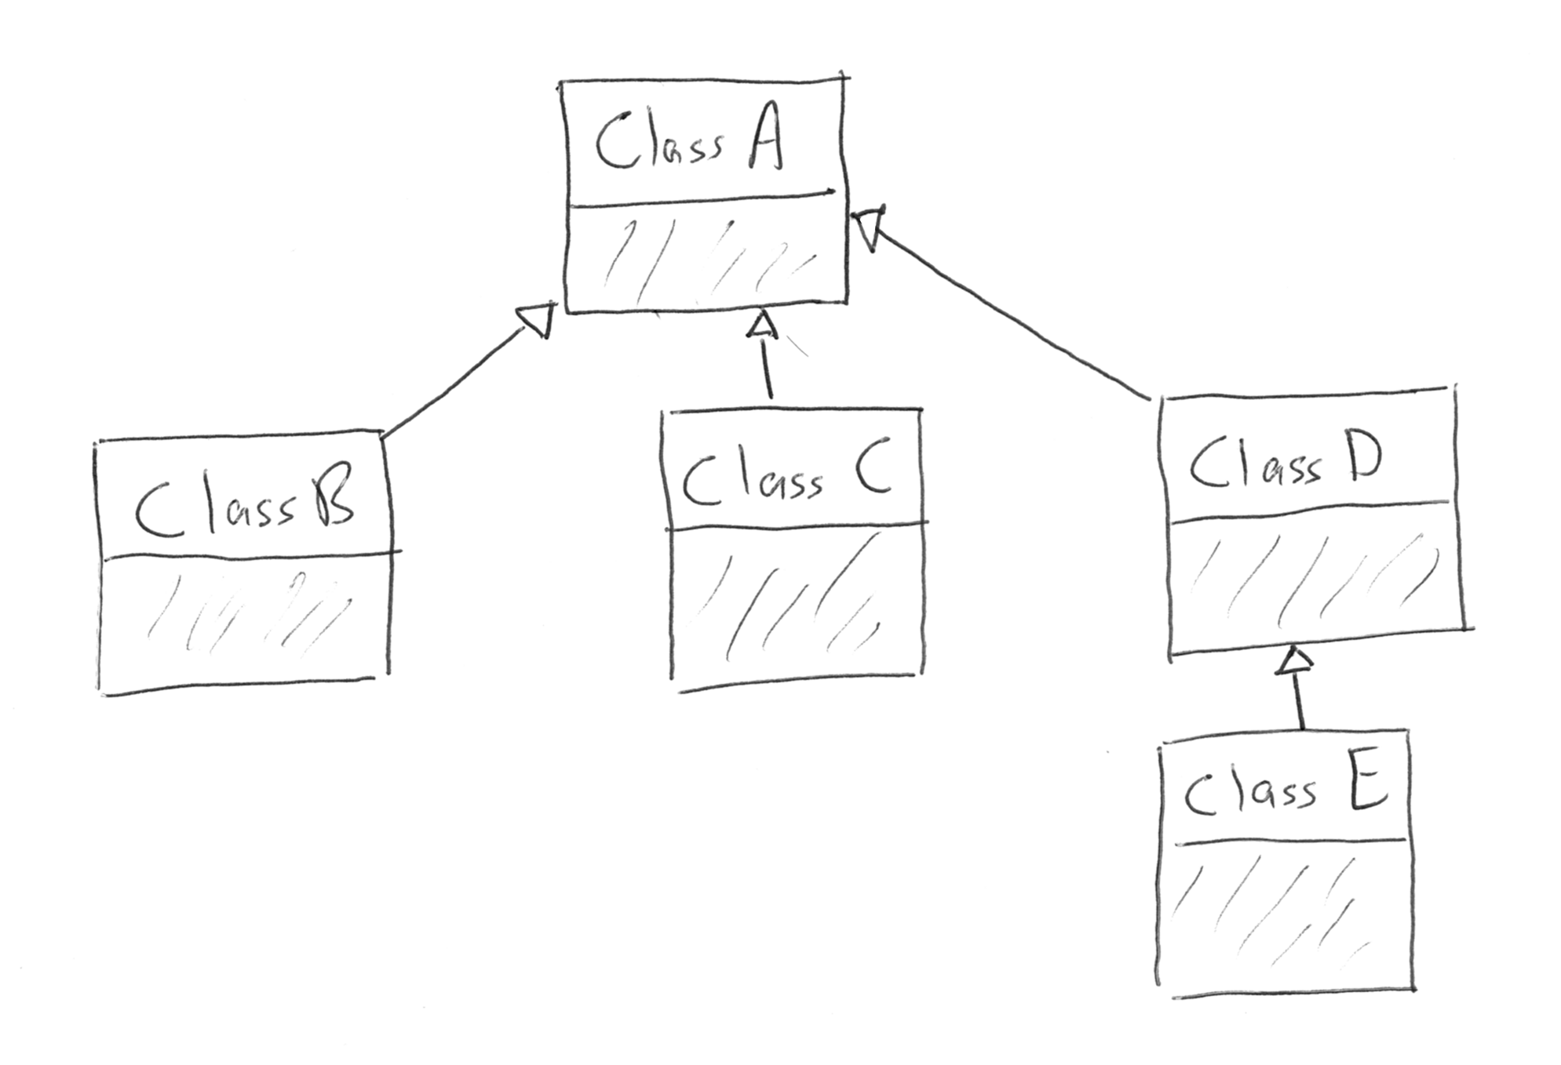
Multiple inheritance diagram/example

Slide 7
Constructors in subclasses
When extending a parent class, the child (or subclass) must call the constructor of the parent class if it’s defined.
This is accomplished via the SUPER keyword.
In our HouseCat class example:
public HouseCat(String name, double weight) {
super(weight);
this.name = name;
}
The super(weight) call is actually calling the constructor in the Cat parent class!

Slide 8
Overriding (again)
We talked about using the @override annotation to override the behavior of the default methods in the Object class (toString, hashcode, etc).
This annotation can also be used to override methods of parent classes.
For example, our Cat class has a method called noise(), we can also have a method in our HouseCat class called noise() as well!
@Override
public String noise() {
return "Hello, my name is " + Name + "!";
}

Slide 9
Note…
The @Override annotation is not required, but it can prevent unintentional errors, and makes it clear when reading your code what you intended to do.
Even though your code will still work, it will be beyond confusing to other developers if you have two methods in classes that inherit from each other that do not have the @override annotation.

Slide 10
Overriding continued…
In order to override a method using the @override annotation, the method signatures MUST be the same.
This is true for the default (object) methods and any methods you wish to override in your own classes and subclasses.
If you’d like, you can call the parent classes method by using the keyword SUPER.
E.g. super.noise(); will call the noise() method in the Cat class from the HouseCat class

Slide 11
Abstract classes
An abstract class is like a normal class, however, it CANNOT be instantiated!
These classes are used to share behavior among classes that inherit from it, but are not meant to be used on their own.
In our Cat example, if we did not want to allow developers to create basic Cat objects, we could make the class abstract. This would prevent the following:
Cat basicCat = new Cat(25.5);

Slide 12
Abstract classes
My personal thought on abstract classes are that they are basically interfaces with default implementations.
Any class that extends an abstract class has the option of overriding a method, or it can use the default implementation if provided by the abstract class. (This is true for non-abstract classes as well)

Slide 13
Abstract methods
Abstract methods are methods that have no implementation, i.e. no code body.
E.g. public abstract String noise();
Once we make a method abstract, subclasses MUST provide their own implementation of the method.
This is exactly the same as providing, interface a method signature in the interface and then implementing the interface. The class that implements the interface MUST provide the implementation for the method.

Slide 14
Data typing (also known as polymorphism)
Since HouseCat is a subclass of cat, this is perfectly legal.
Cat suki = new HouseCat("Suki", 8);
This is acceptable because a HouseCat is a Cat.
If we call a method on suki above, such as noise(), it will call the noise() method of the HouseCat class because even though we declared it as a Cat object, we created an instance of a HouseCat object.

Slide 15
There’s a catch!
There’s a catch to this, however, is that if the method is NOT defined in the Cat class, but IS defined in the HouseCat class, we won’t have access to it unless we declare the object as a HouseCat.
// Results in a compiler error, since Cat doesn't have such a method
suki.isSatisfied();
To fix this, just declare suki as a HouseCat: HouseCat suki = new HouseCat(“suki”, 25.5);

Slide 16
UML Diagrams
Unified Modeling Language…
UML diagrams are fairly common in industry when designing large applications/solutions.
I honestly can’t remember the last time I created a formal UML diagram.
The concepts are important and you should be made aware of them!

Slide 17
Diagramming a class
Top: Class name
E.g. Student
Middle: Fields/Variables and their types (String, int, Boolean, etc.)
E.g. name: String, studentId: int
Bottom: Methods/Functions (+ is public, - is private)
+ getName()
+ getStudentId()
- calculateGPA()

Slide 18
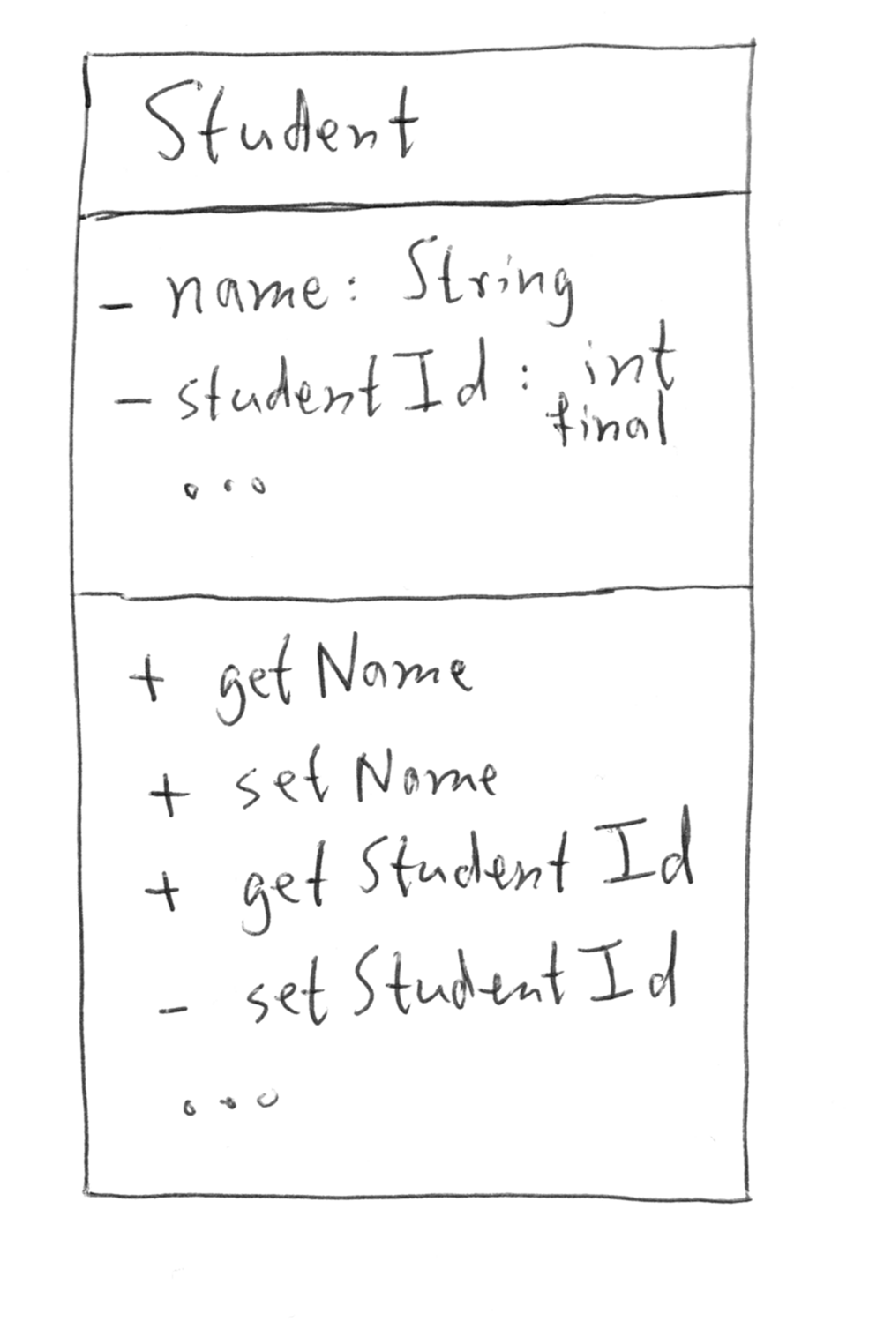
Picture example

Slide 19
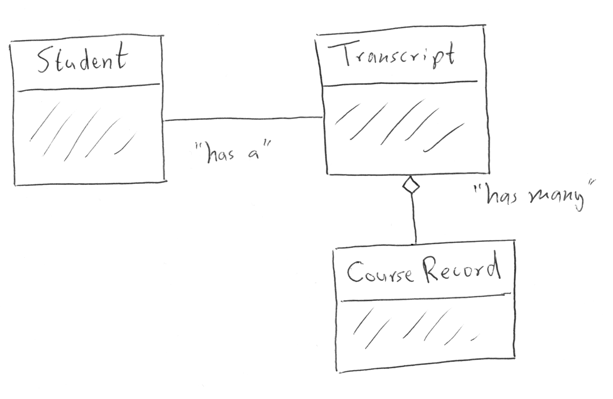
Diagramming relationships

Slide 20
Relationsihps & diagrams
A plain, solid line between two classes indicates a one-to-one relationship. For each Student there is ONE Transcript, and a Transcript can be owned by only one Student.
A line with an open diamond on the end indicates a one-to-many relationship. Each Transcript has many CourseRecord objects.
This is similar to an ERD (entity-relationship diagram) for my DB folks!

Slide 21
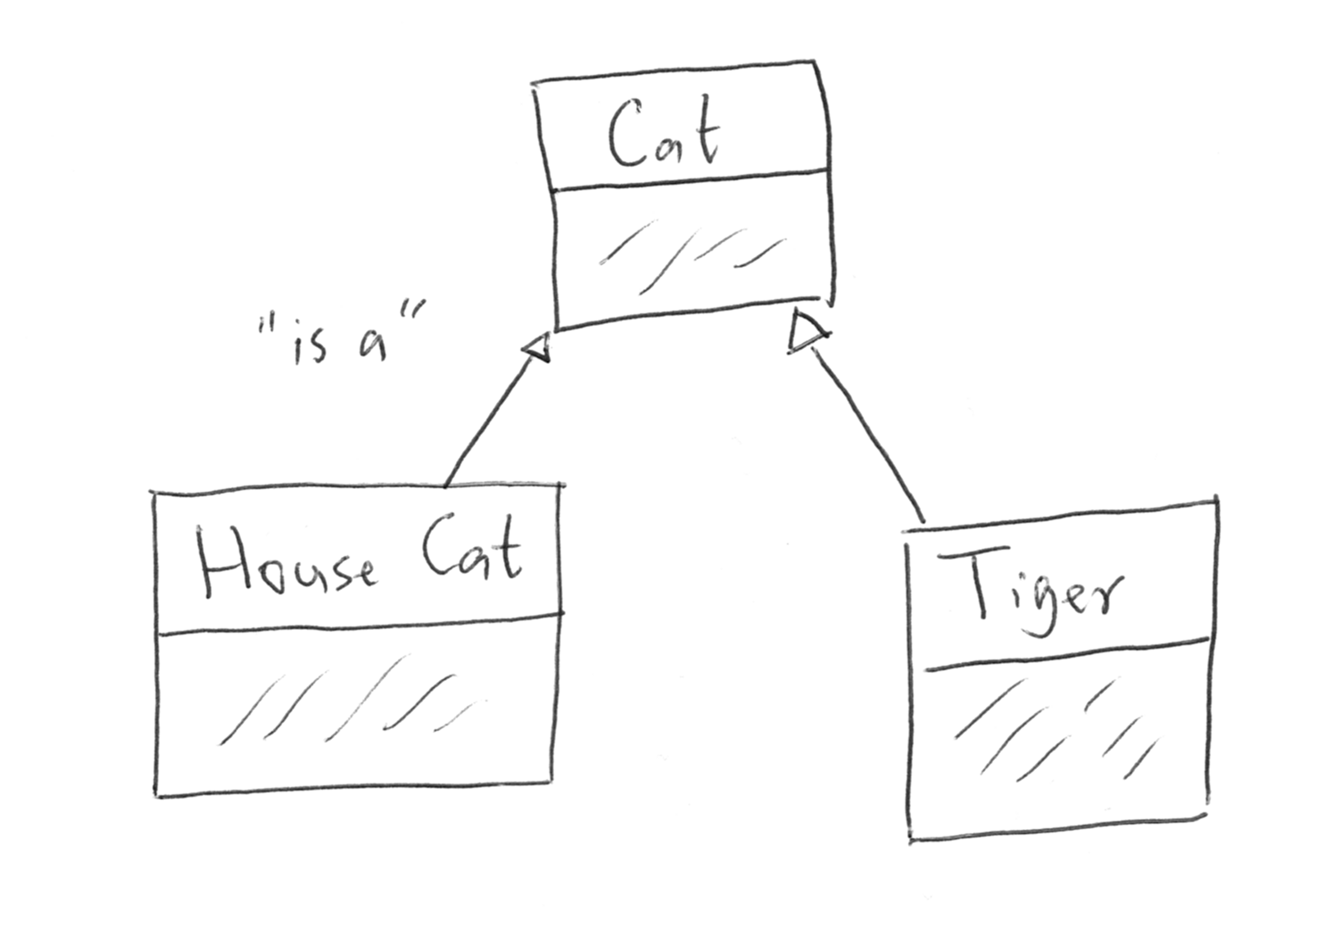
Diagramming inheritance

Slide 22
Inheritance & diagrams
A line with an arrow between two classes indicates an inheritance (parent/child) class relationship.
This is considered in “is-a” relationship
In our example, HouseCat and Tiger “is-a” Cat.

Slide 23
Next…
Quiz time studio!
https://education.launchcode.org/skills-back-end-java/studios/quiz-time/
Twist: I’ve been asked to provide a solution for this studio, as such, I will be working on this studio alongside you today and will gladly go over my solution with whoever would like ☺

